Slide 1
Enriching Taxonomies With Functional Domain Knowledge
Advisor: Jia-Ling, Koh
Source: ACM SIGIR '18
Speaker: Shao-wei, Huang
Date: 2019/02/12

Slide 2
Outline
Introduction
Method
Experiment
Conclusion

Slide 3
Outline
Introduction
Method
Experiment
Conclusion

Slide 4
Introduction
Augment a taxonomic hierarchy by accurately placing novel or unfamiliar concepts in it at an appropriate location and level of granularity.
無危物種
IUCN紅色名錄
澳雨蛙亞科
滅絕物種
澳大利亞動物
兩棲類
龜膽科
Category
IUCN無危物種
雨濱蛙屬
澳大利亞兩棲類
溪蟾亞科
溪蟾屬
IUCN絕滅物種
New entity
大雨蛙
Entity
儲水蛙
胃育蛙
棕樹蛙
湍雨濱蛙
白氏樹蛙
綠紋樹蛙

Slide 5
Introduction
Challenges
Detection of previously unknown entities or concepts.
Insertion of the new concepts into the knowledge structure, respecting the semantic integrity of the created relationships

Slide 6
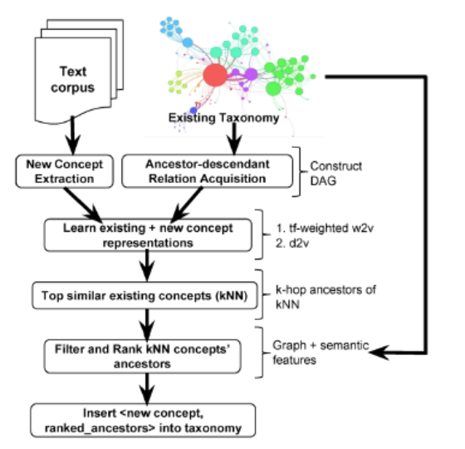
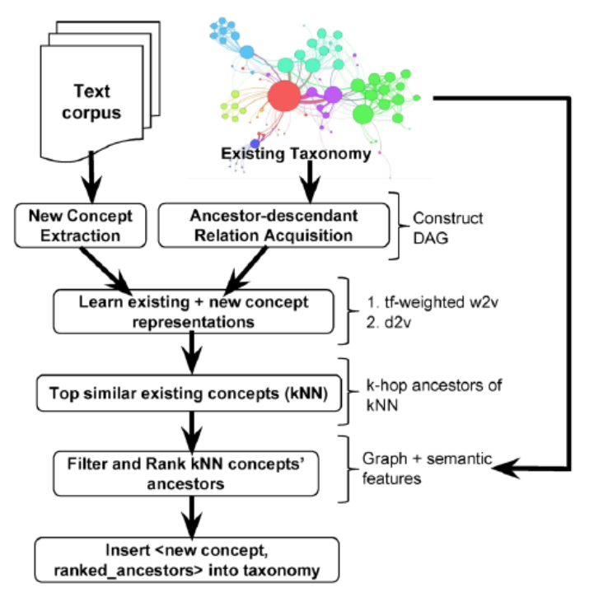
Introduction
Problem definition & Framework
Input
A corpus of unseen, unlabeled, unstructured text documents containing a set of new concepts X.
A taxonomic hierarchy of categories and entities, T.
A corpus of text documents D associated with the concepts present in T.
Output
If concept x not in T, then a solution x into T by outputting a set of semantically appropriate parents in T for x.

Slide 7
Outline
Introduction
Method
Experiment
Conclusion

Slide 8
Method
Find concepts and Taxonomic relations
Acquire the entities and categories from the given taxonomic structure and utilize their ancestor-descendant relationships to construct T.
Use Bi-LSTM and CRF to extraction new concept from text corpus.

Slide 9
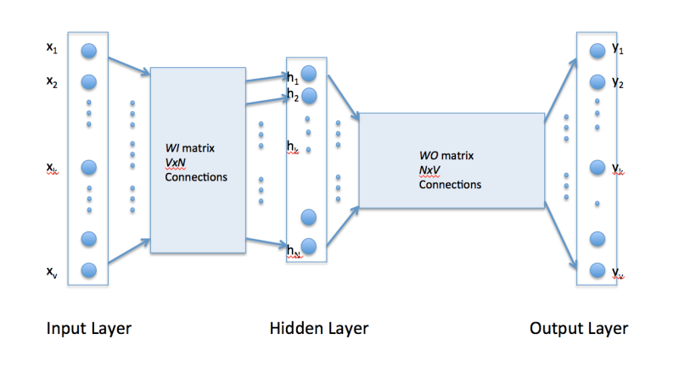
Method
doc2vec解說
Learning concept representations
Exist concept
Word2vec：
Doc2vec：replace all occurrences of entity names in the corpus D of existing text documents(removes a great deal of ambiguity from the corpus).
$$e_{i}$$
Aggregate
$$e_{i}$$
New concept
Word2vec：add the tf-weighted sum of its context terms.(approximate)
Doc2vec：generate c as targets and infer a doc2vec by keeping the current doc2vec model.
Aggregate

Slide 10
Method
Filter potential parents
Potential parents：
Find the k-nearest neighbours(kNNs) of new concept.
The potential parents for the new concepts are highly likely to be in common with the ancestors of these kNNs.

Slide 11
Method
Learning to rank解說
Ranking potential parents
Learning to rank：
Pairwise model

Slide 12
Method
Ranking potential parents
Graph-based features：
Katz Similarity
Random Walk Betweenness Centrality
Information Propagation Score
Semantic features：
Ancestor-Neighbor Similarity
New concept-Ancestor Similarity
Pointwise Mutual Information (PMI)

Slide 13
Method
Ranking potential parents
Katz Similarity(Graph-base)
(EX)
p
Assume $l_{max}$ = 3 and η = 0.2
l = 1 → = ${0.2}^{1}$ * 1
l = 2 → = ${0.2}^{2}$ * 1
l = 3 → = ${0.2}^{3}$ * 2
x

Slide 14
Method
Ranking potential parents
Random Walk Betweenness Centrality(Graph-base)
How often a node be passed by.
(EX)
1
2
 | $$V_{1}$$ | $$V_{2}$$ | $$V_{3}$$ | $$V_{4}$$ | $$I_{1}$$ | $$I_{2}$$ | $$I_{3}$$ | $$I_{4}$$
S=1 ; t=2 | 1 | 0 | 0 | 0 | 1 | 1 | 0 | 0
S=1 ; t=3 | 1 | 0 | -1 | 0 | 1 | 1 | 1 | 0
S=1 ; t=4 | 2 | 1 | 1 | 0 | 1 | 1 | 0 | 1
S=2 ; t=3 | 0 | 0 | -1 | 0 | 0 | 1 | 1 | 0
S=2 ; t=4 | 1 | 1 | 1 | 0 | 0 | 1 | 0 | 1
S=3 ; t=4 | 1 | 1 | 2 | 0 | 0 | 1 | 1 | 1
3
4
s：起點
t：終點

Slide 15
Method
Ranking potential parents
Information Propagation Score(Graph-base)
(EX)
p
Parameter： $δ=$0.005, $α$ = 0.75, $β$ = 0.005
$$u_{1}$$
= ($\frac{\left(1−0.005\right) ∗IP(u)}{1^{0.75} ∗{ e}^{2∗0.005}})$
+ ($\frac{\left(1−0.005\right) ∗IP(u)}{2^{0.75} ∗{ e}^{2∗0.005}})$
= $\frac{\left(1−0.005\right) ∗0.5}{3^{0.75} ∗{ e}^{1∗0.005}}$
v
$$u_{1}$$
$$u_{2}$$
$$u_{2}$$
w = 0.5
$$x_{1}$$
u

Slide 16
Method
Ranking potential parents
Ancestor-Neighbor Similarity(Semantic-base)
Term overlap between the text document linked to its potential parents, and that associated with each of its nearest neighbor entities.
New concept-Ancestor Similarity(Semantic-base)
Computes the Jaccard similarity between the document associated with the new concept, and those associated with potential parents.
Pointwise Mutual Information (PMI)(Semantic-base)

Slide 17
Outline
Introduction
Method
Experiment
Conclusion

Slide 18
EXPERIMENT
Dataset
Wikipedia:
This taxonomy exceeds 5 million concepts.
WordNet:
This dataset contains 1000 concepts, split into a training set of 400 and a testing set of 600 concepts, which are either nouns or verbs.

Slide 19
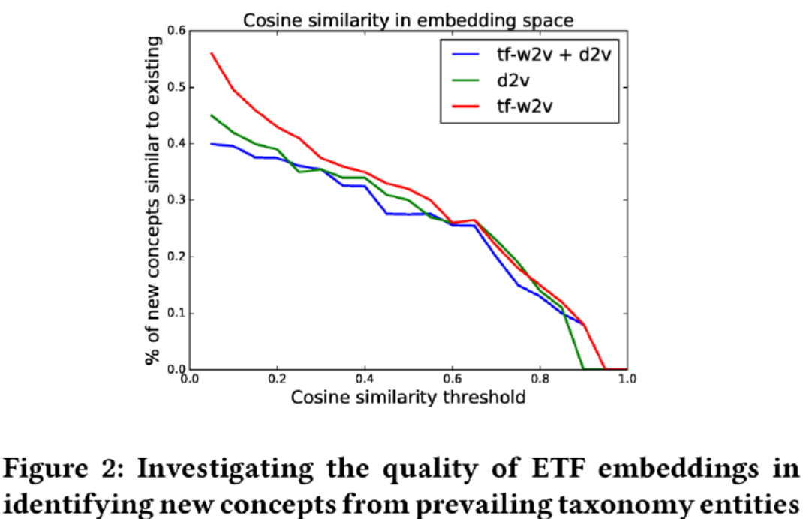
EXPERIMENT
Wikipedia

Slide 20
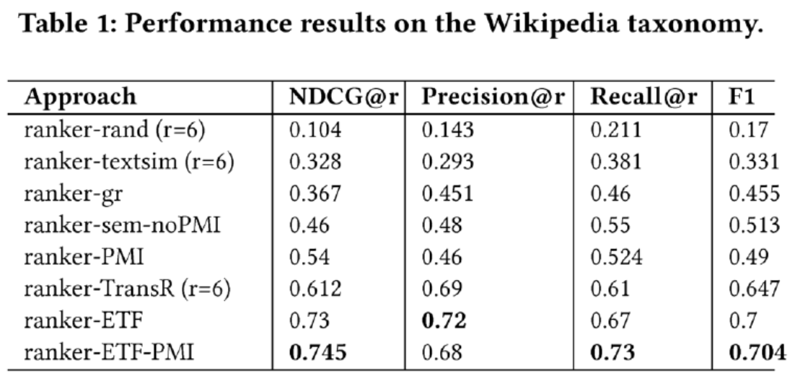
EXPERIMENT
Wikipedia

Slide 21
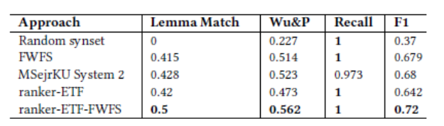
EXPERIMENT
WordNet
Wu&P：predicted parent $x_{1}$ and the true parent $x_{2}$ as Wu&P($x_{1}$,$x_{2}$) =
Lemma Match：how often the system picked the right word but wrong sence.
Recall：the percentage of test concepts for which an output ancestor was identified by an algorithm.
F1 score：Harmonic mean of theWu&Palmer score and recall.

Slide 22
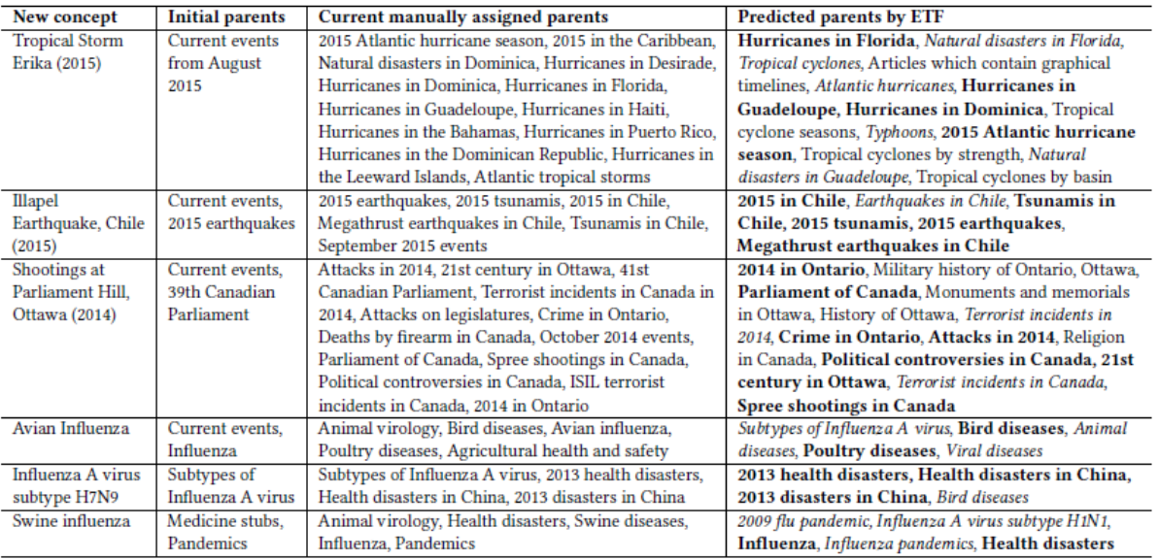
EXPERIMENT
2015年埃里卡熱帶風暴
危及應對
2015年智利Illapel地震
2014年渥太華連環槍擊案
醫學領域
禽流感
豬流感

Slide 23
Outline
Introduction
Method
Experiment
Conclusion

Slide 24
Conclusion
We propose a solution to the problem of automated taxonomy enrichment, where we insert new concepts at appropriate positions into an existing taxonomy.
Our proposed approach ETF learns a high-dimensional vector embedding via a generated context of terms, for each existing and new concept.
We then predict the potential parents of the new concepts from the ancestors of their nearest neighbors, by ranking them based on semantic and graph features.

